Slide 1

Paper Prototyping
- Group 3
Cuiting Huang huang.cui@northeastern.edu
Xiaolan Wu wu.xiaol@northeastern.edu
Yichao Wu wu.yicha@northeastern.edu

Slide 2
Introduce of our app
Fooriend
Fooriend is an easy-to-use and smart recipe sharing app. You can share your recipes, find recipes of different cuisines from all of the world and also leave your comment to others' recipes and get advice from other users, which helps you make friends by cooking and sharing!
List of the Screens
Notifications - a screen asks users to allow push
Home Screen - shows recipes categories(e.g hot, recent, all)
Location Screen - shows recipes by users’ location
(Chosen Screens) List of Countries to Choose
Viewing a Recipes - details screen of recipes
(Chosen Screens) Add Screen - for users to share their recipes
Collection Page - shows users’ favorite recipes
Profile Screen
Sign in/ Sign up Screen

Slide 3
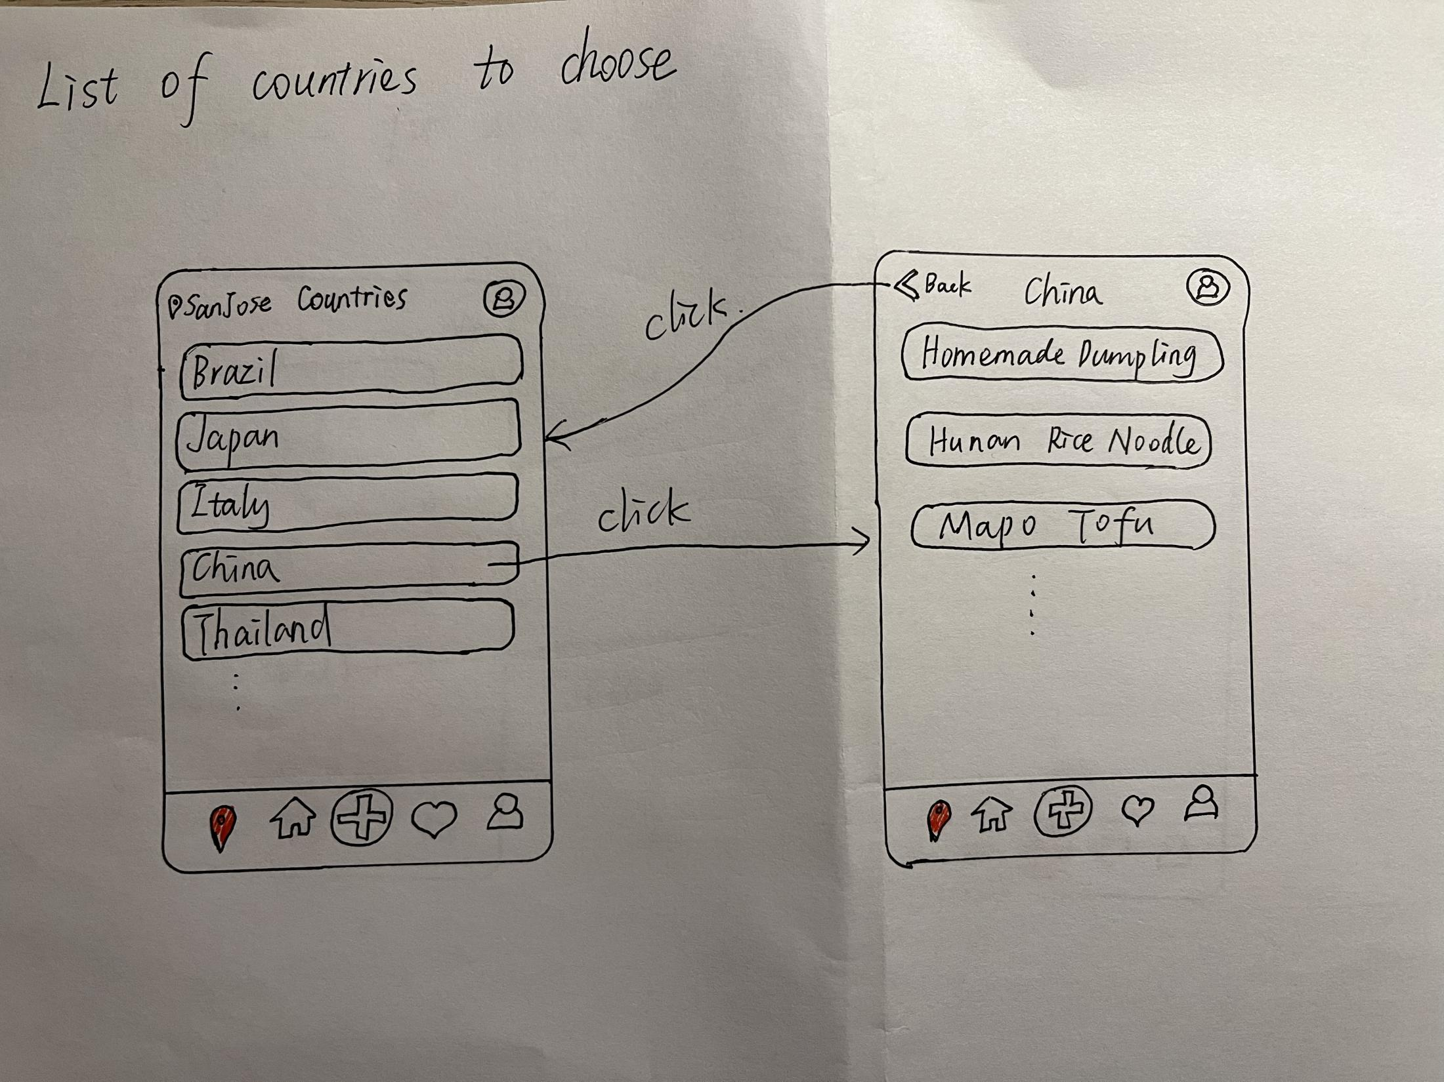
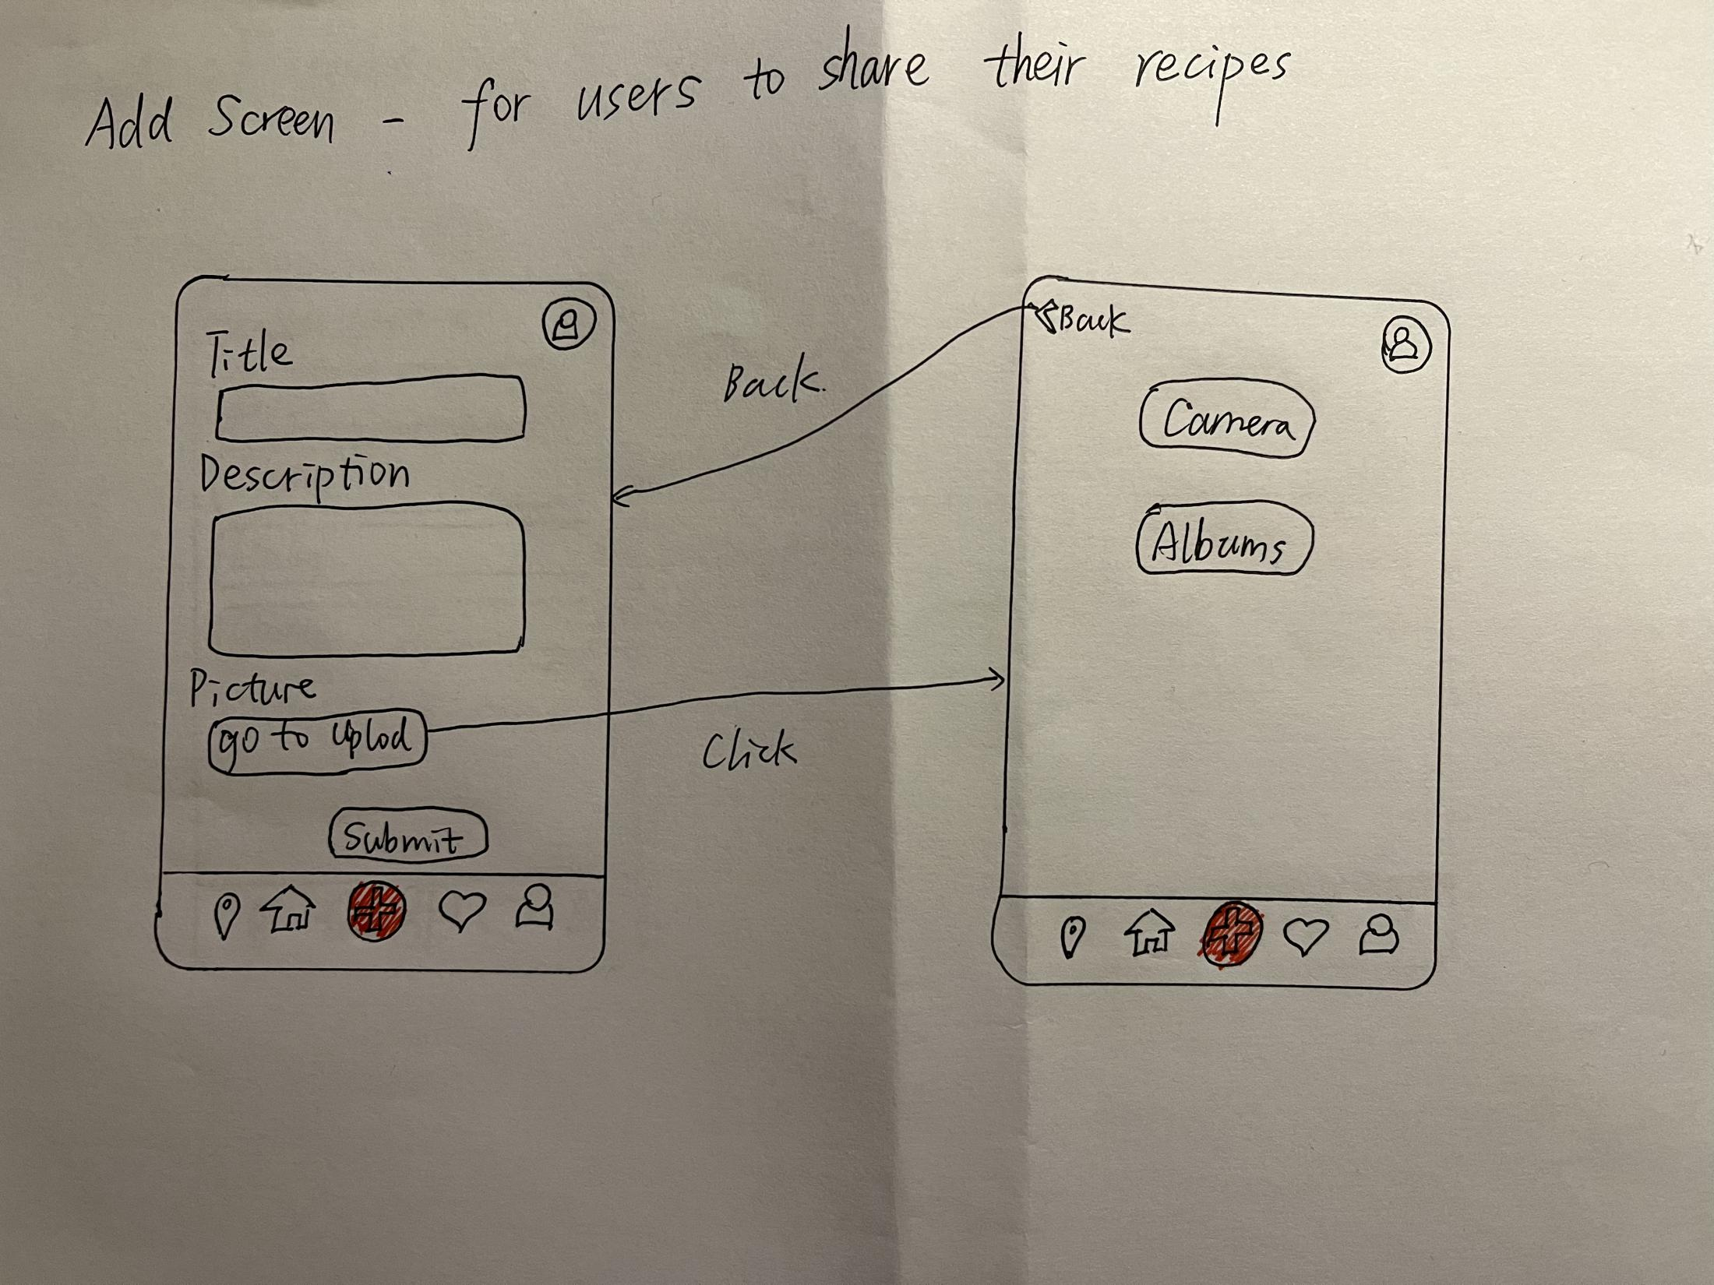
The Chosen Screens
List of Countries to Choose
Add Screen

Slide 4
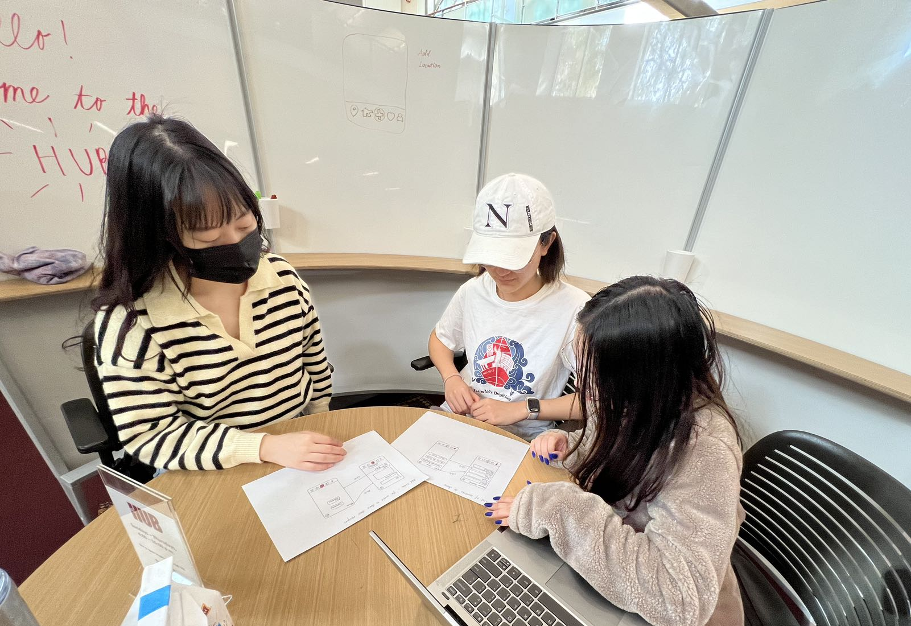
Target Users Description
Someone who is interested in cooking, including those from beginner to professional cook, from different countries and cultures.
Someone who wants to share/discuss/optimize their recipes with other cooking-lover in the network, make friends by cooking and explore different foods worldwide.
Test User: Chen Yao
Test User: Luhan Wen
Photo 1: our member is explaining the test process

Slide 5
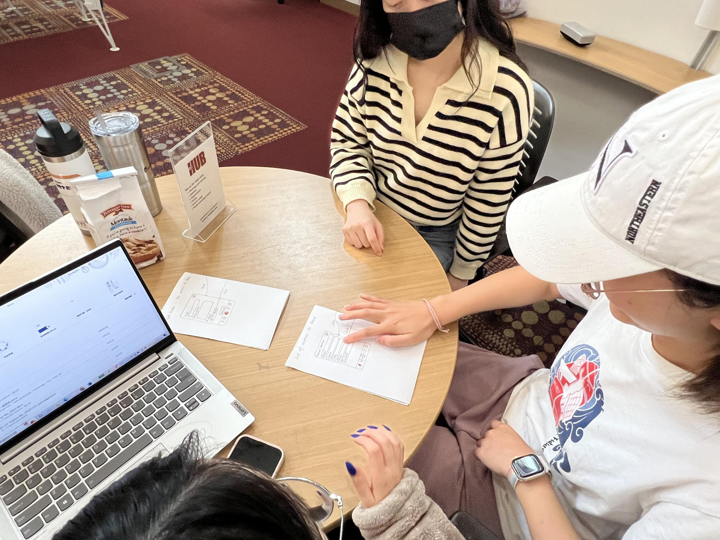
Process of Paper Prototyping - List of Countries to Choose
Photo 2: test user clicks country “China”

Slide 6
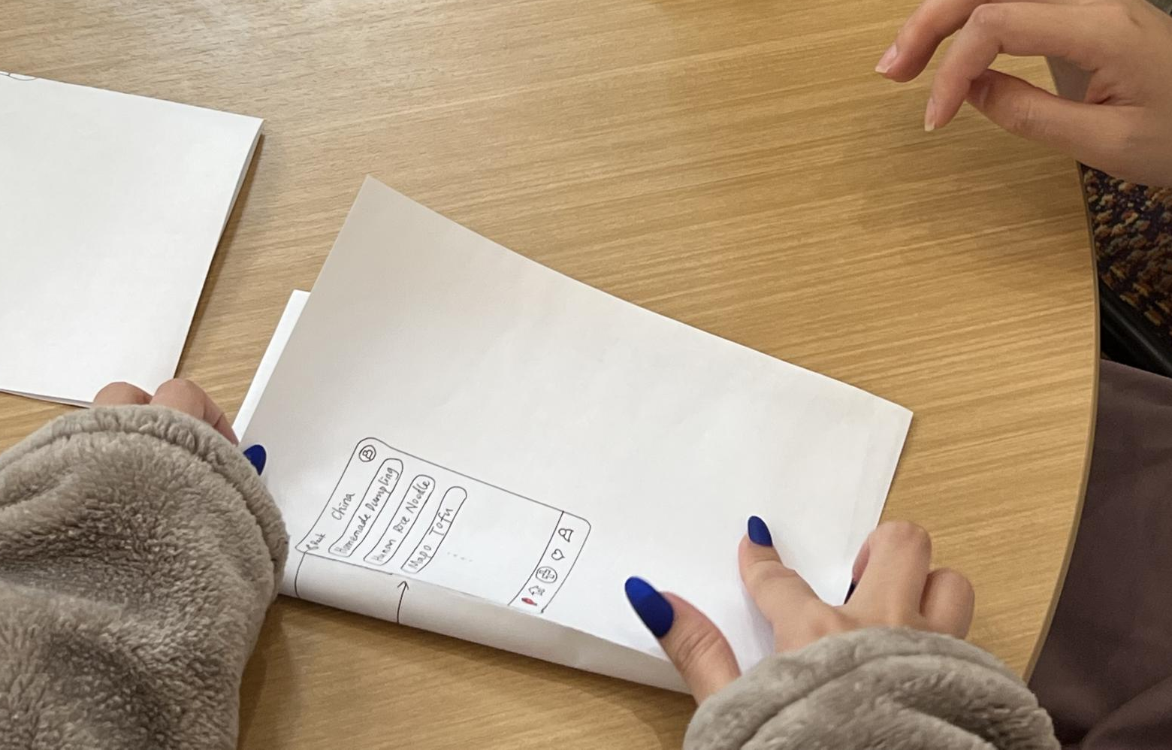
Process of Paper Prototyping - List of Countries to Choose
Photo 3: Jump to China recipes screen

Slide 7
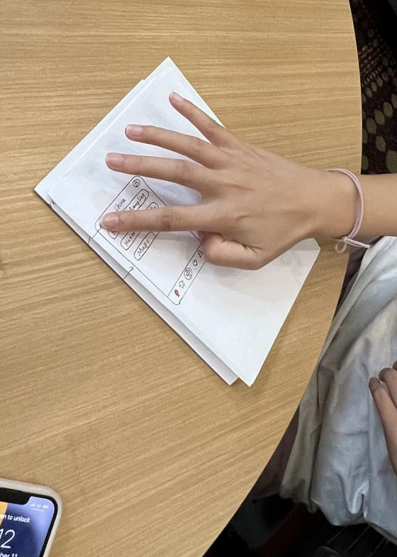
Process of Paper Prototyping - List of Countries to Choose
Photo 4: test user clicks “back”

Slide 8
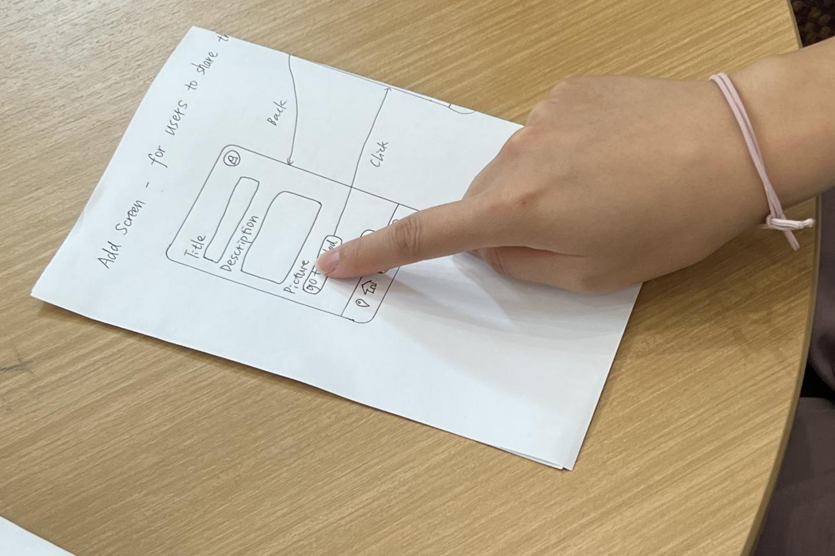
Process of Paper Prototyping - Add Screen
Photo 5: test user clicks “upload image”

Slide 9
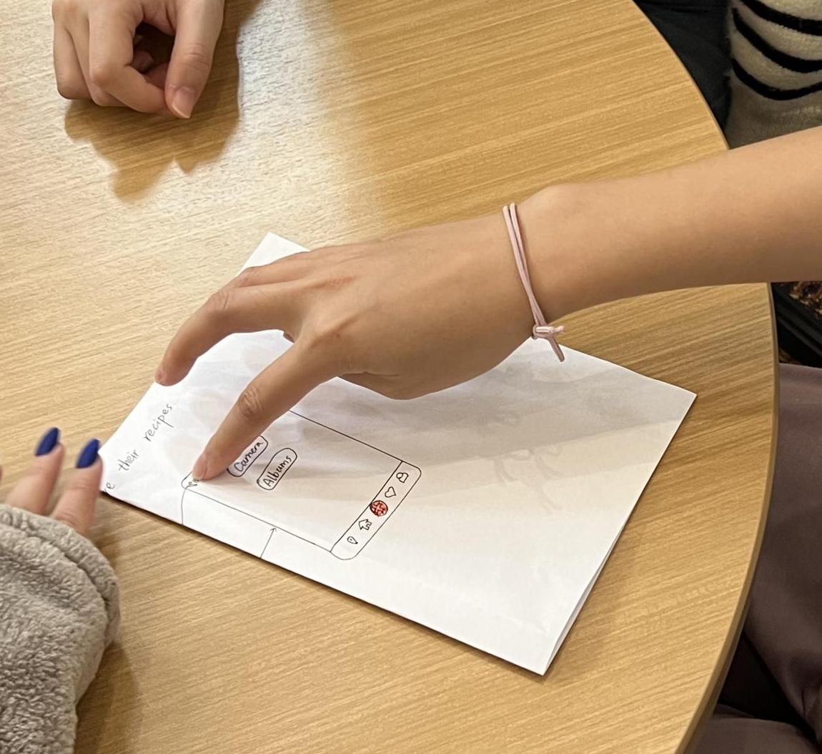
Process of Paper Prototyping - Add Screen
Photo 6: test user clicks “back”

Slide 10
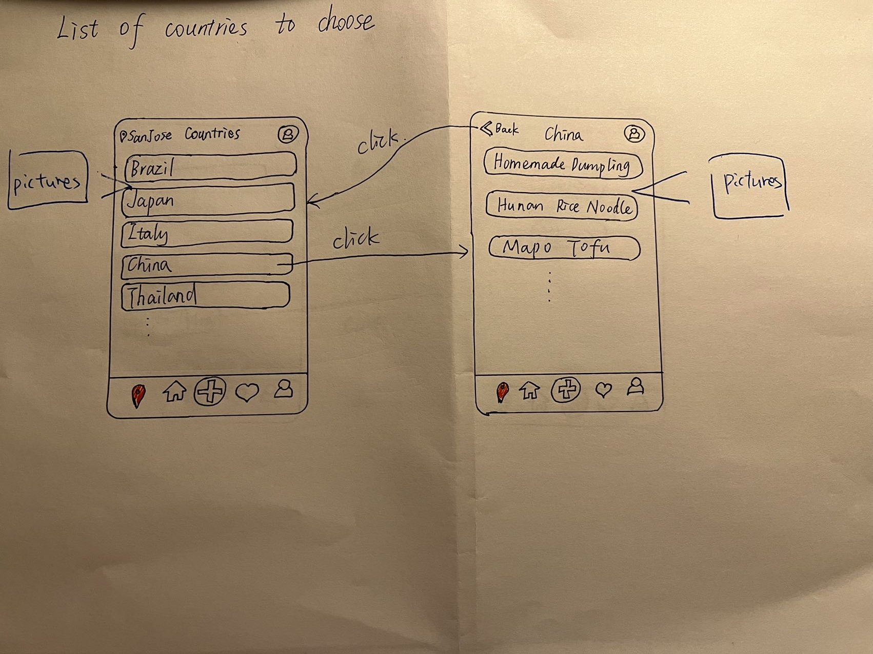
Feedback and Sketches
- List of Countries to Choose
Reactive feedback:
Like: Simple and use to understand and use; function that can select recipes by countries is impressive
Dislike: screen title is confused; only text on screen
Reflective feedback(suggestions):
Designers can add food pictures under the country subtitle bar
Highlighted places are added by test users

Slide 11
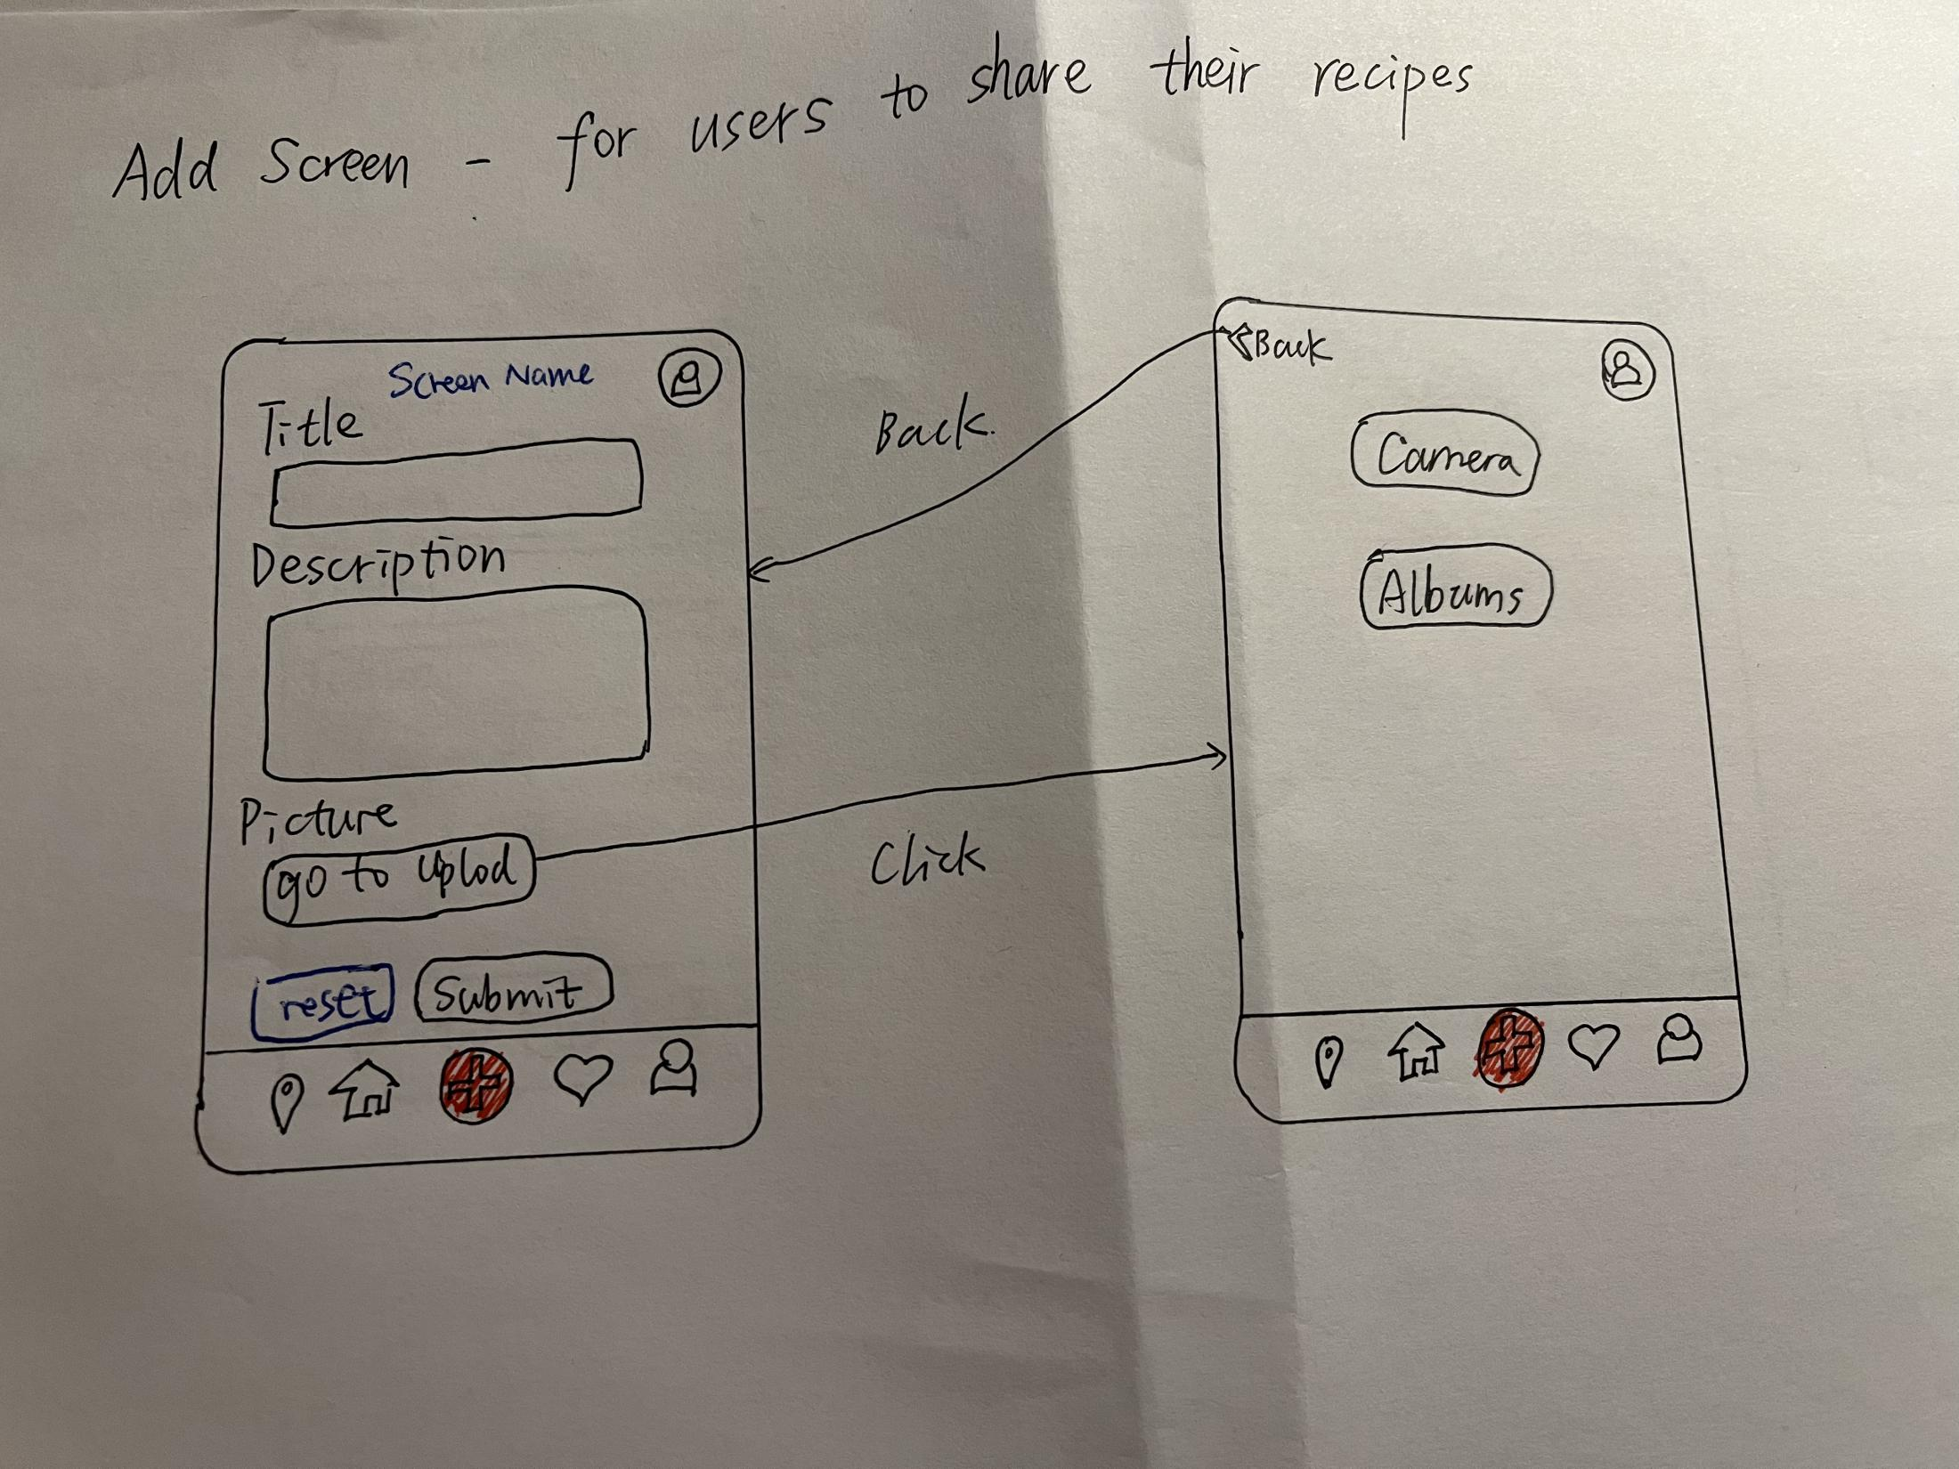
Feedback and Sketches
- Add Screen
Reactive feedback:
Like: recipes picture upload button is easy to find
Dislike: no reset button, no title on screen, cannot upload multiple pictuereds
Reflective feedback(suggestions):
Add reset button, location selector and title on screen; add function that can delete pictures seperately
Highlighted places are added by test users

Slide 12
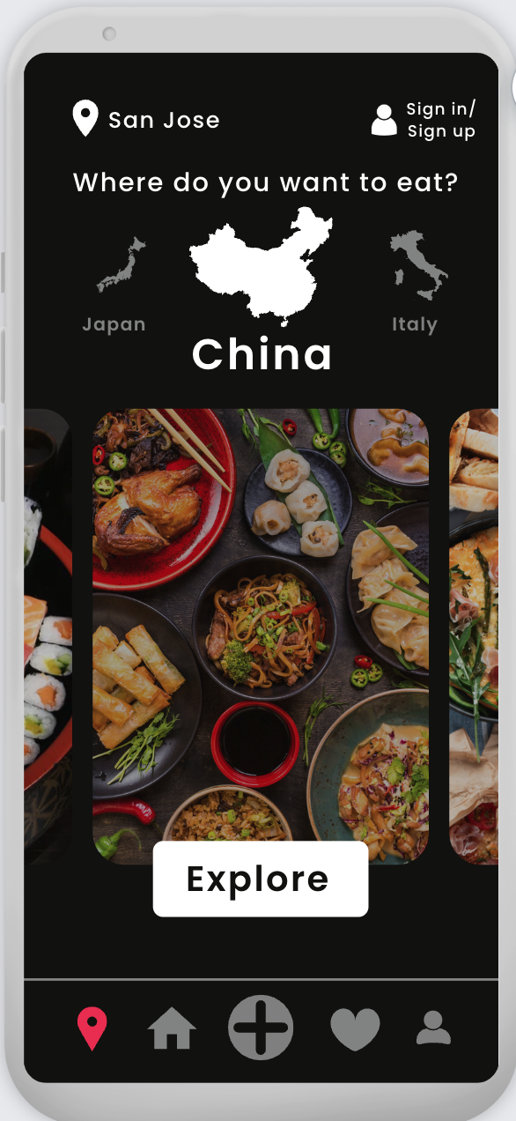
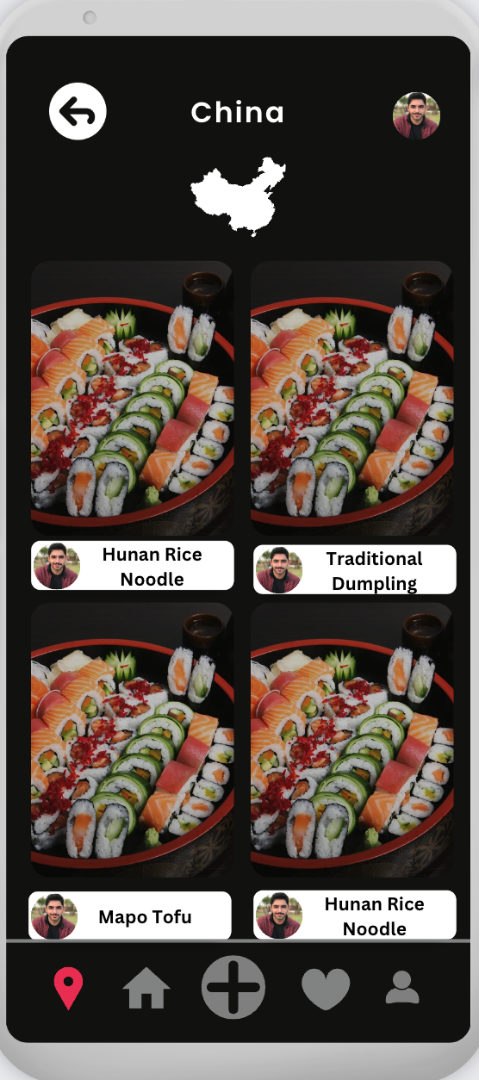
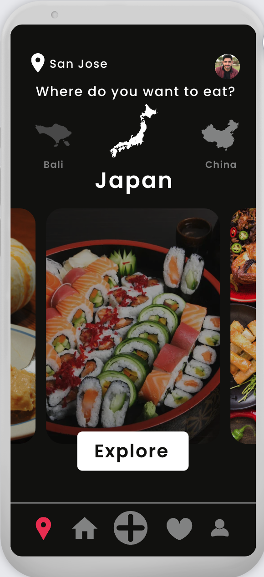
Design the chosen screens based on the feedback
List of Countries to Choose
We can scroll the image of country map to select our expected location and explore the food in specific locations.
By clicking the explore button, we can go to a nested page, where we can see the recipes of food from selected locations.

Slide 13
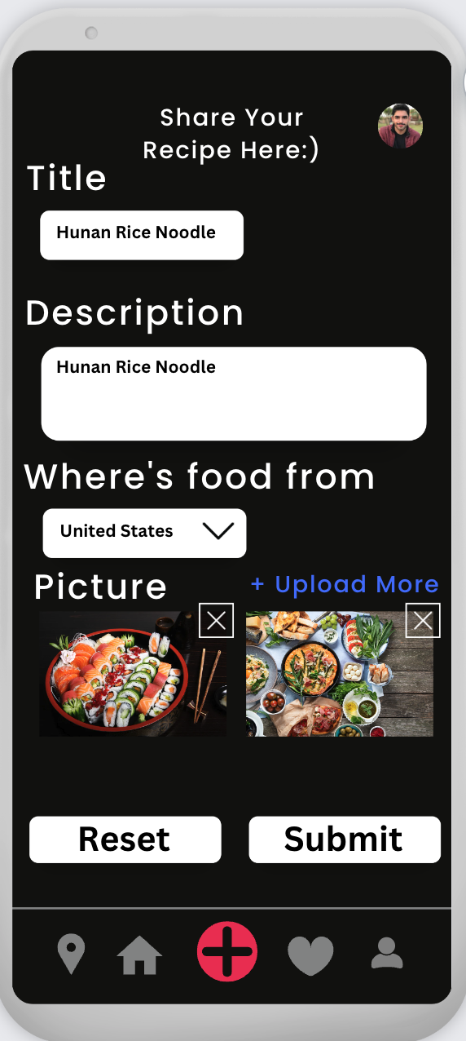
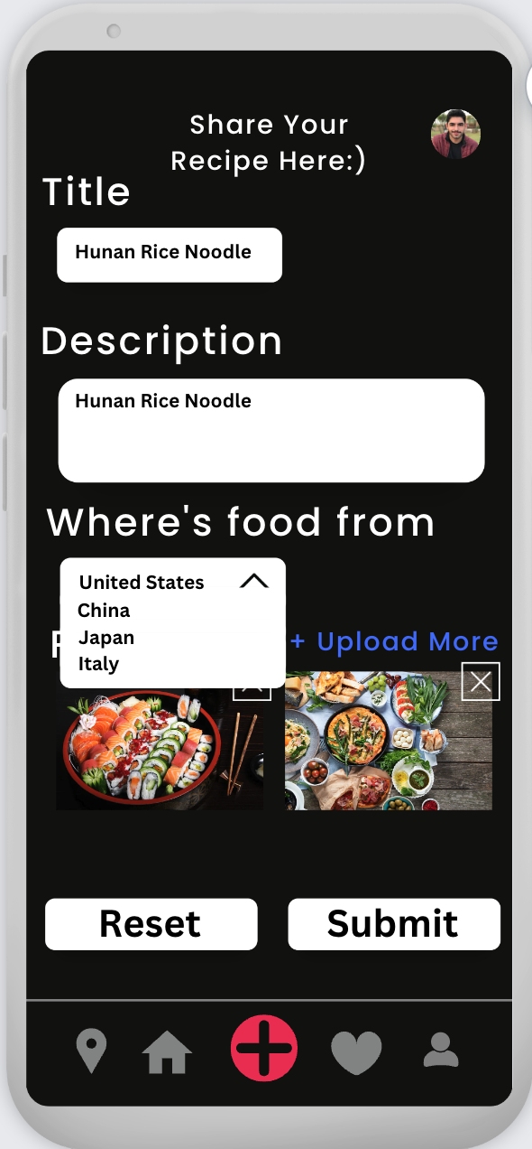
Design the chosen screens based on the feedback
Add Screen
We can delete uploaded images by clicking the “x” button in the right-top corner of separate image.
We can also click the blue”Upload More” button to upload picture s from camera or album.

